Slide 1
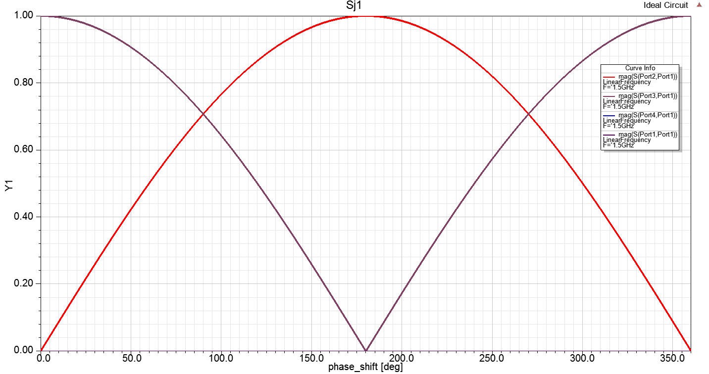
Ideal Variable Coupler

Slide 2
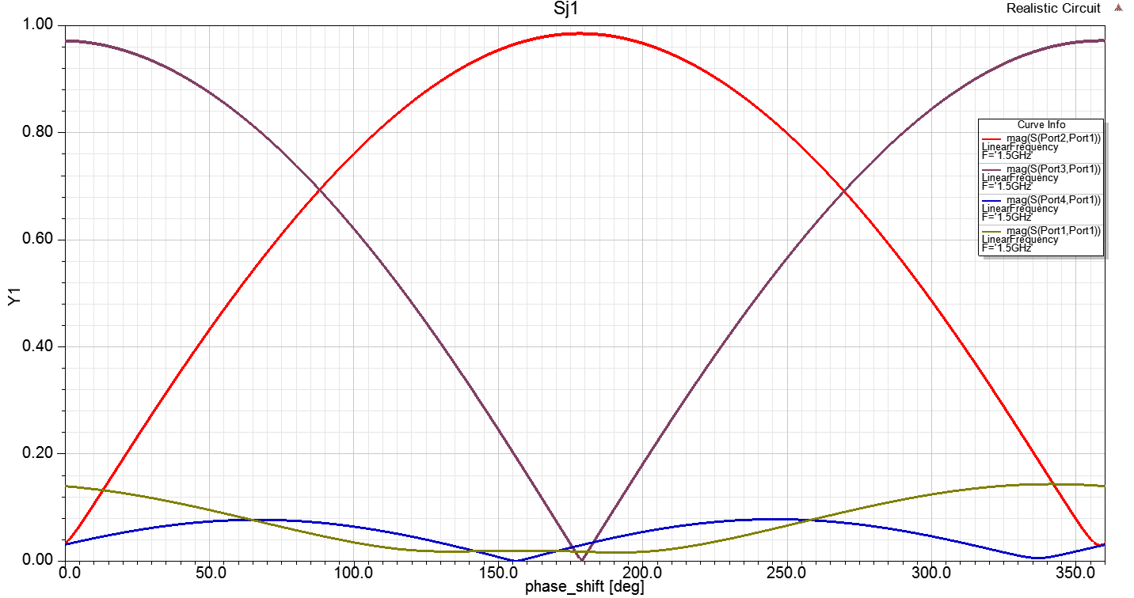
Variable Coupler with measured S-parameter for the hybrid couplers

Slide 3
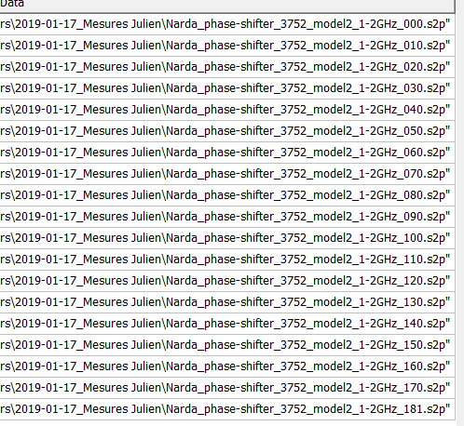
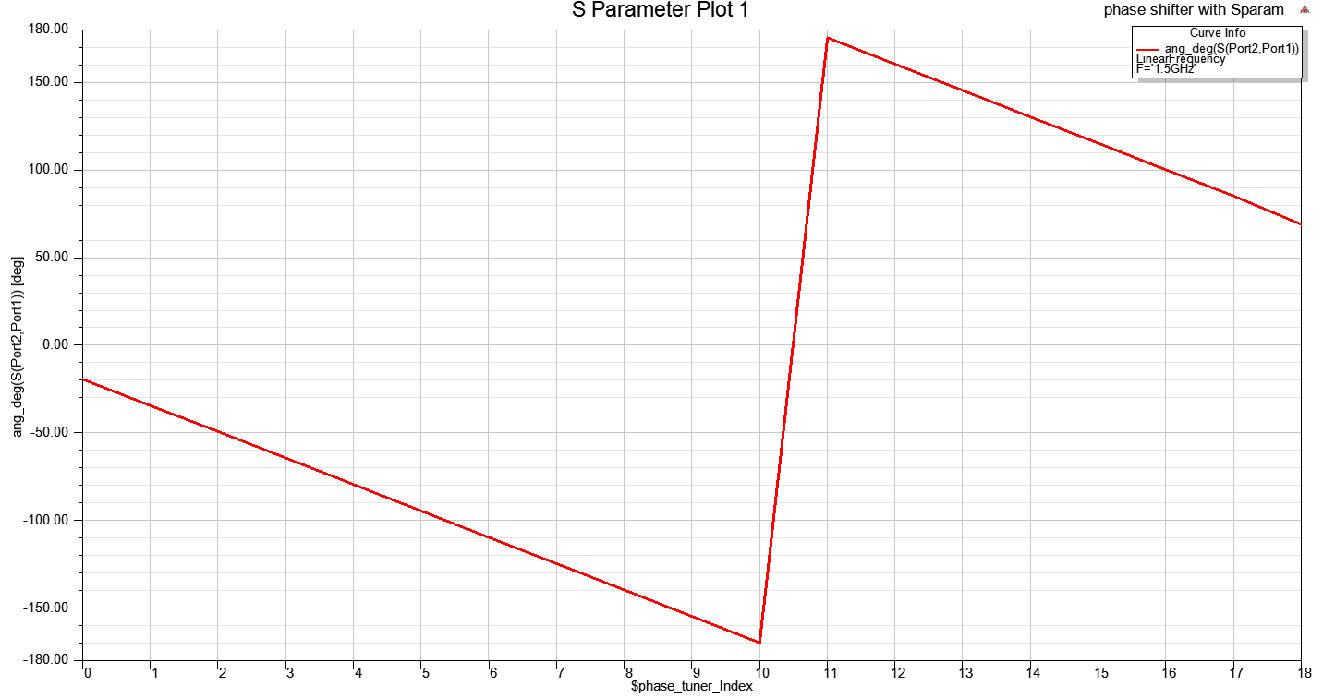
Phase Shifter
19 measurements
Gives relationship
btw index (button) and phase shift

Slide 4
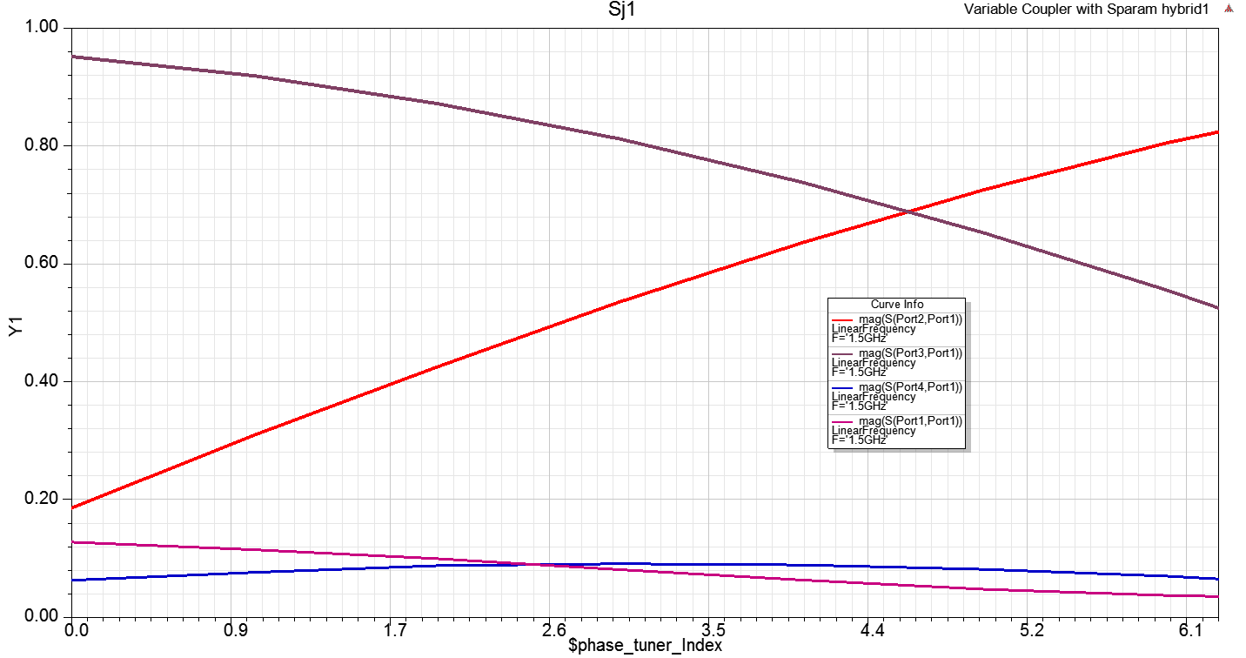
Variable coupler with both hybrids and phase shifter described by the measured S-parameters

Slide 5
Variable coupler with both hybrids and phase shifter described by the measured S-parameters
S param index replaced by the phase shift value at 1.5GHz

Slide 6
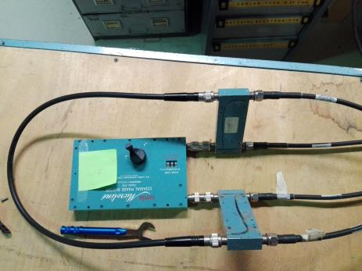
Measured Variable Coupler
Zone non accessible

Slide 7
Comparaison mesures vs calculs utilisant les matrices S mesurées. La différence provient des câbles et transitions

Slide 8
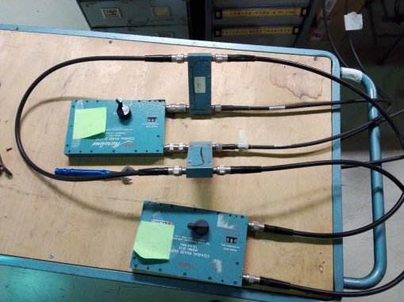
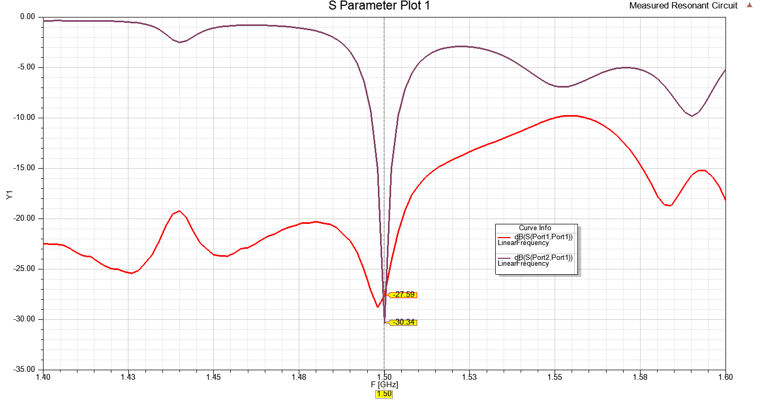
Resonant Circuit
Ça marche même avec des câbles ;)

